Slide 1
Posting summary Based on content
Analysis of the suicide tendencies

Slide 2
Data Source
From Kaggle. The dataset is named "Suicide and Depression Detection"
The dataset is a collection of posts from the “SuicideWatch”（from Dec 16, 2008(creation) till Jan 2, 2021) and "depression" (Jan 1, 2009, to Jan 2, 2021) subreddits of the Reddit platform. Posts collected from SuicideWatch are labeled as suicide, while posts collected from the depression subreddit are labeled as depression. Non-suicide posts are collected from r/teenagers.

Slide 3
Challenge
problem
solution
Data clean contains emoji
import emoji
df = ...
df['messages'] = df['messages'].apply(lambda s: emoji.replace_emoji(s, ‘’))

Slide 4
Why Suicidal Tendencies

Slide 5
Humanistic care value
Patients
Others
Reducing the suicide rate due to psychological disease.
Having chance to do something to reduce or forbid something may makes their feels guilt when it happened.

Slide 6
Business Value
For Medical system,
Reduce manpower usage and improve efficiency
In 2022, the American Hospital Association quoted an estimate that half a million nurses would leave the field by the end of that year, bringing the total shortage to 1.1 million.
There are demand and there is increasing in demand
After declining in 2019 and 2020, suicide deaths increased approximately 5% in the United States in 2021. The provisional estimates released today indicate that suicide deaths further increased in 2022, approximately 2.6%.
from Centers for Disease Control and Prevention

Slide 7
Value for Country or Society
Medical system
Improve the effectiveness and timeliness of treatment.
Reduce the number of patients who die by suicide due to negligence in supervision
Social stability
Social media

Slide 8
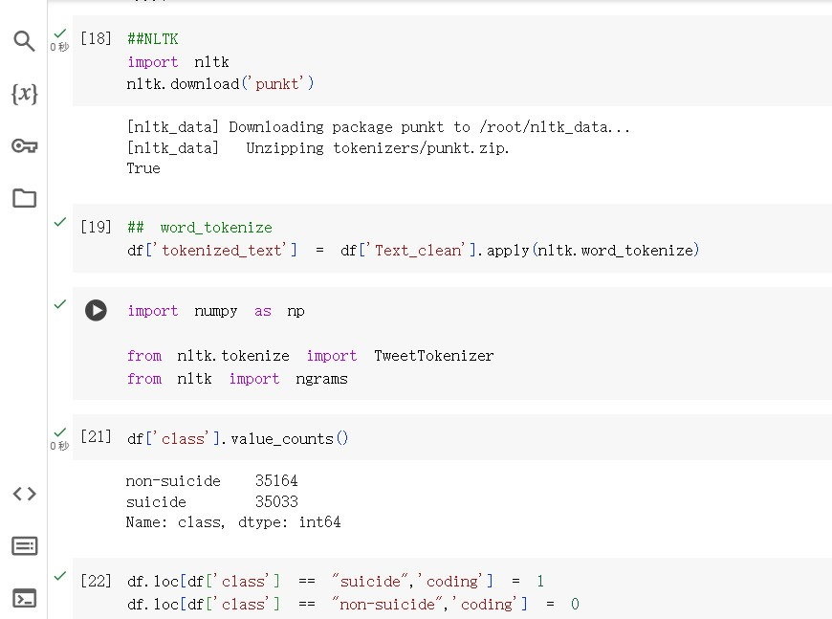
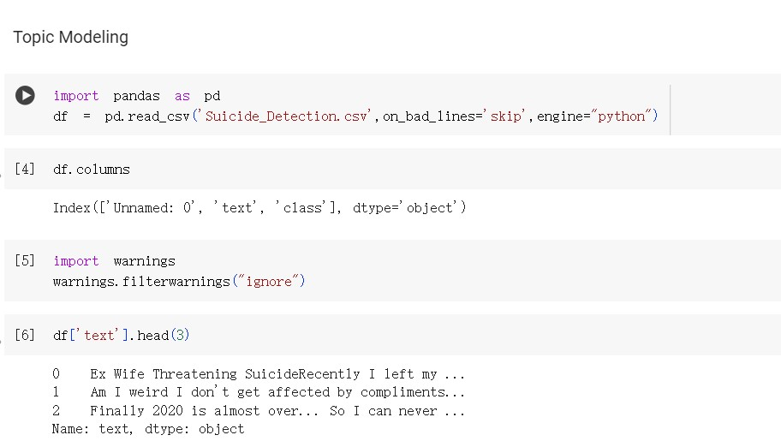
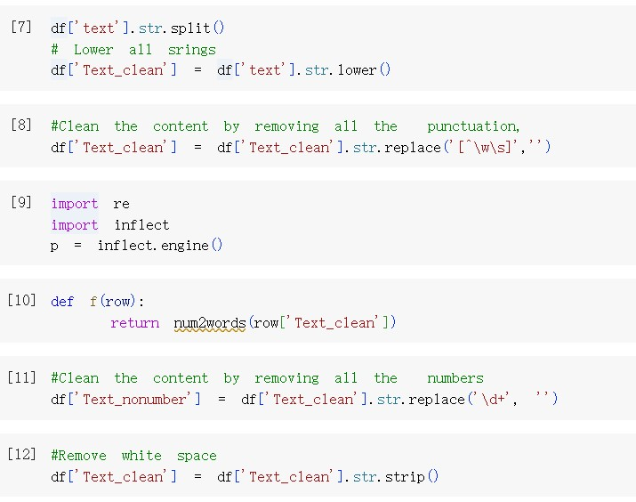
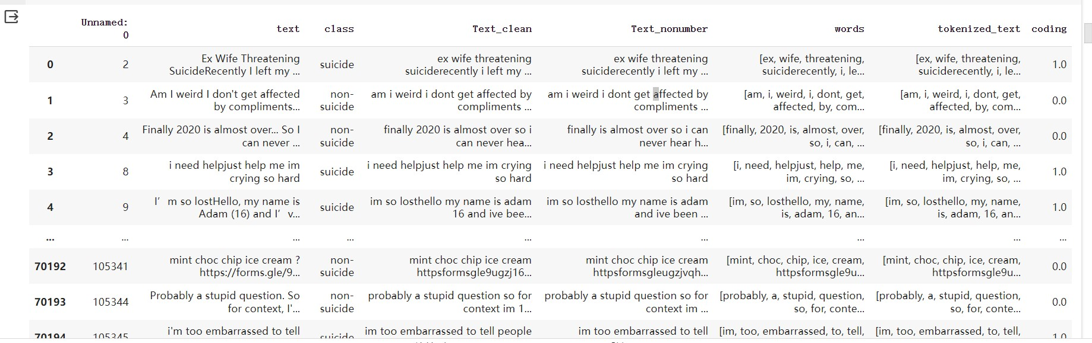
Data Loading, Wrangling

Slide 9
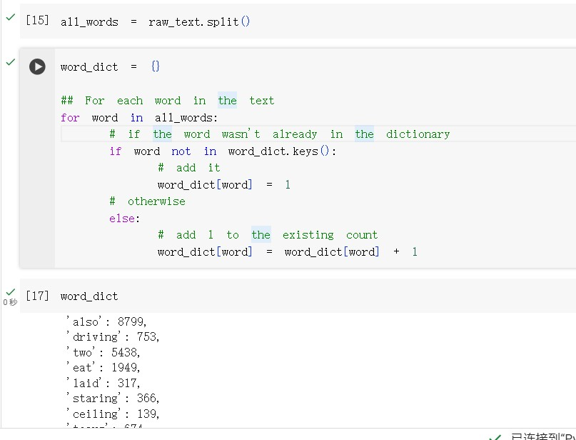
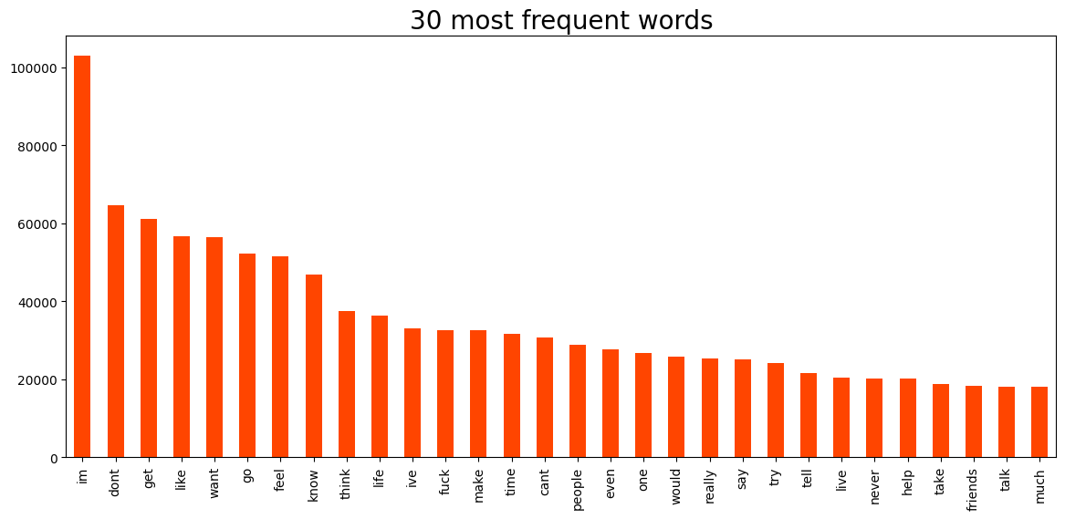
Frequency

Slide 10
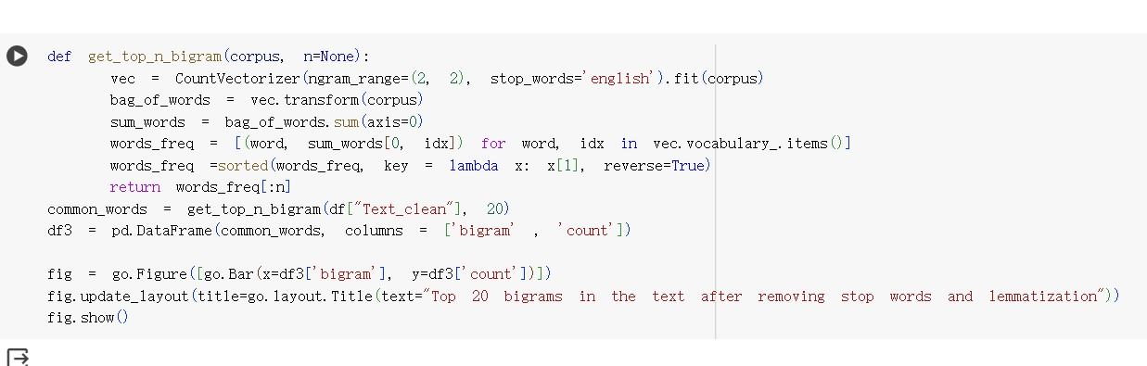
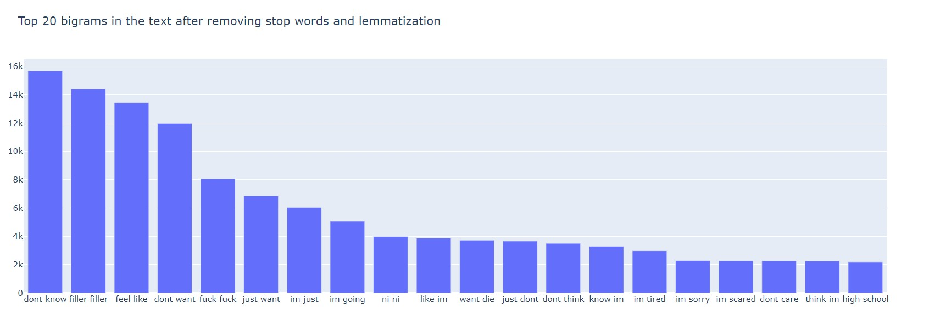
Ngram

Slide 11
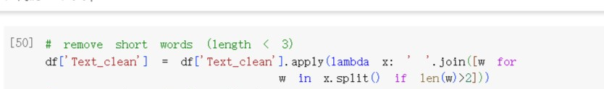
Remove Words (Too short)

Slide 12
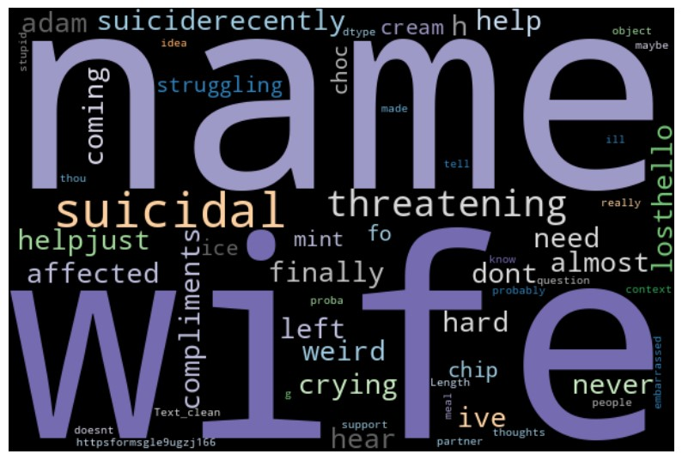
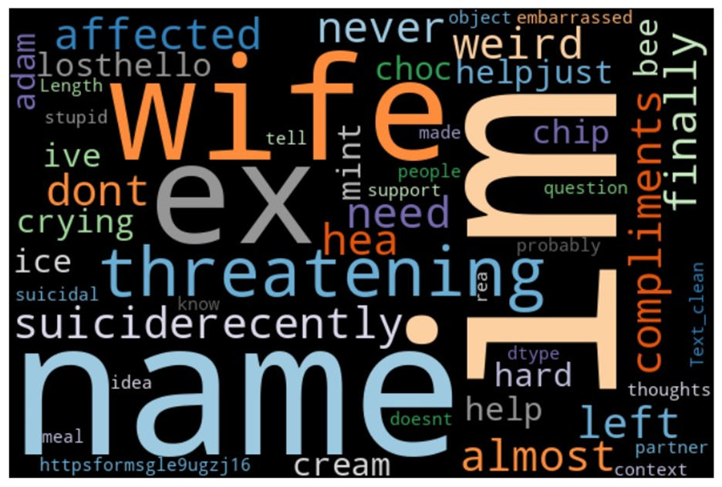
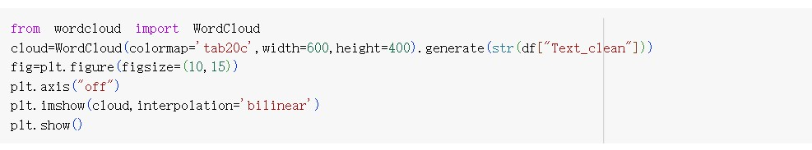
WordCloud

Slide 13
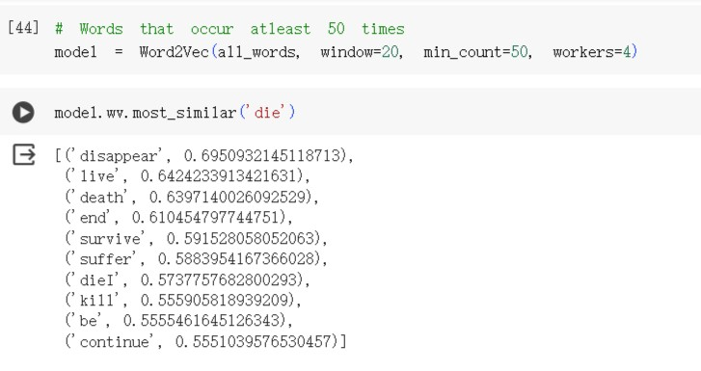
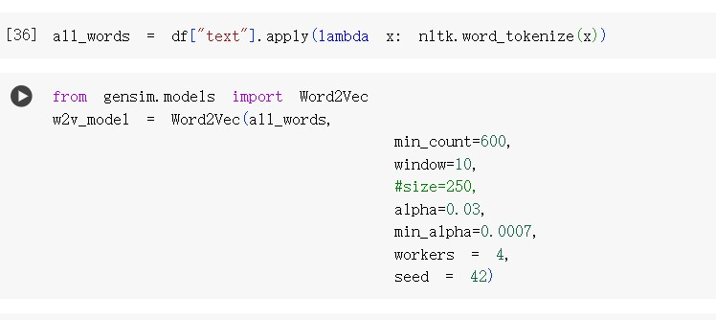
Word2Vec

Slide 14
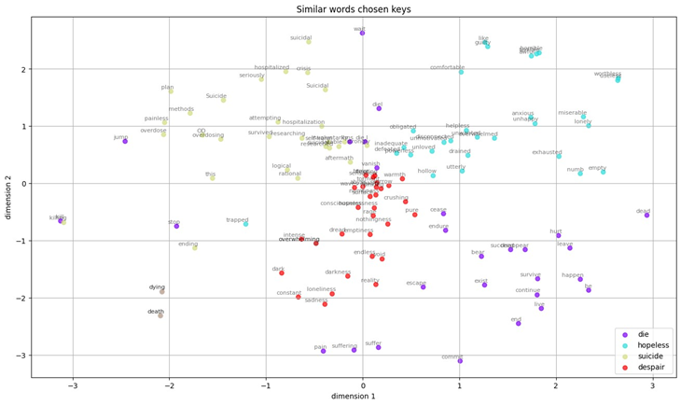
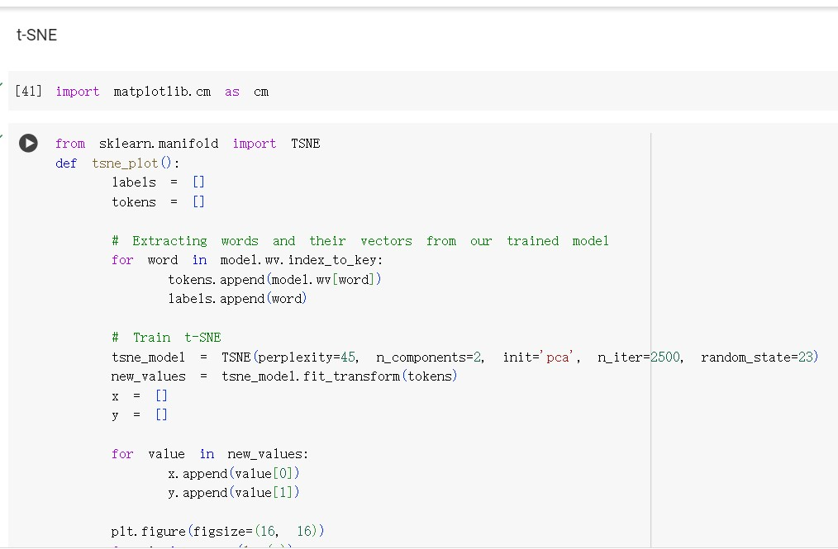
T-SNE

Slide 15
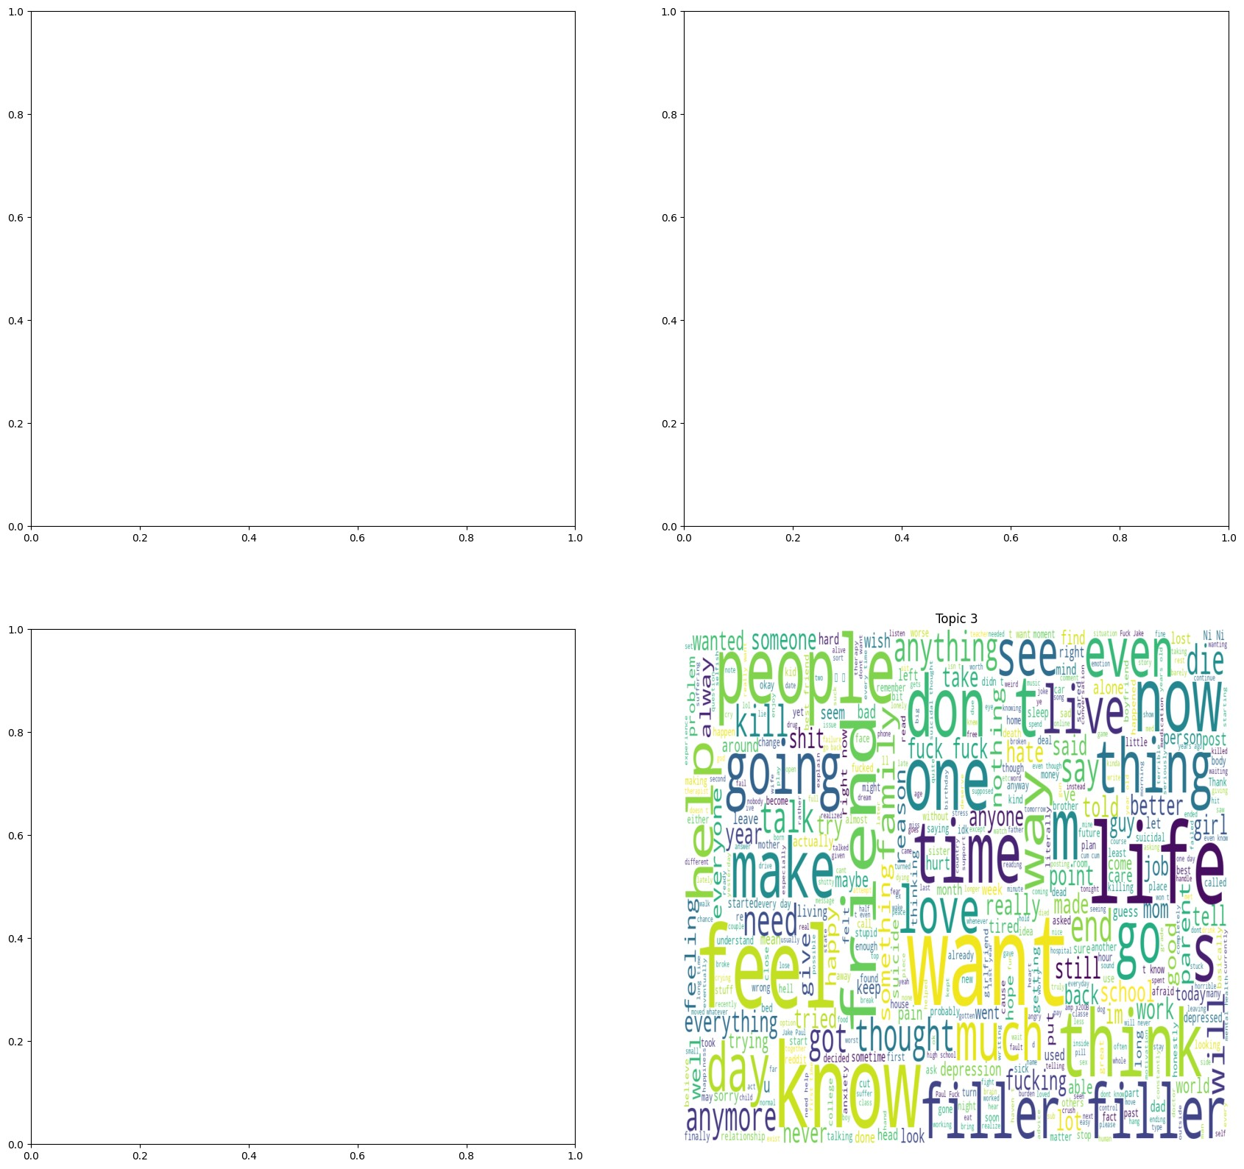
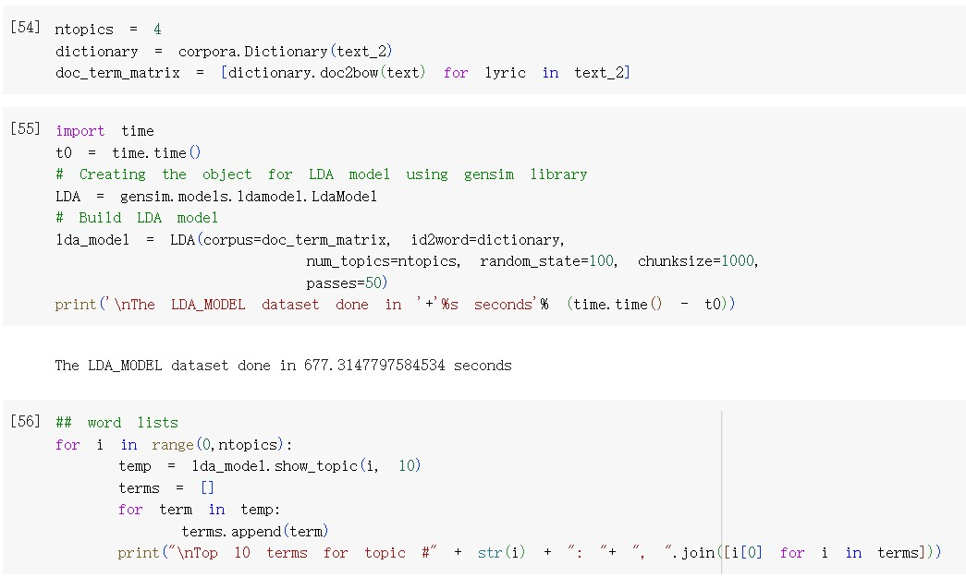
Topic Modeling: LSA

Slide 16
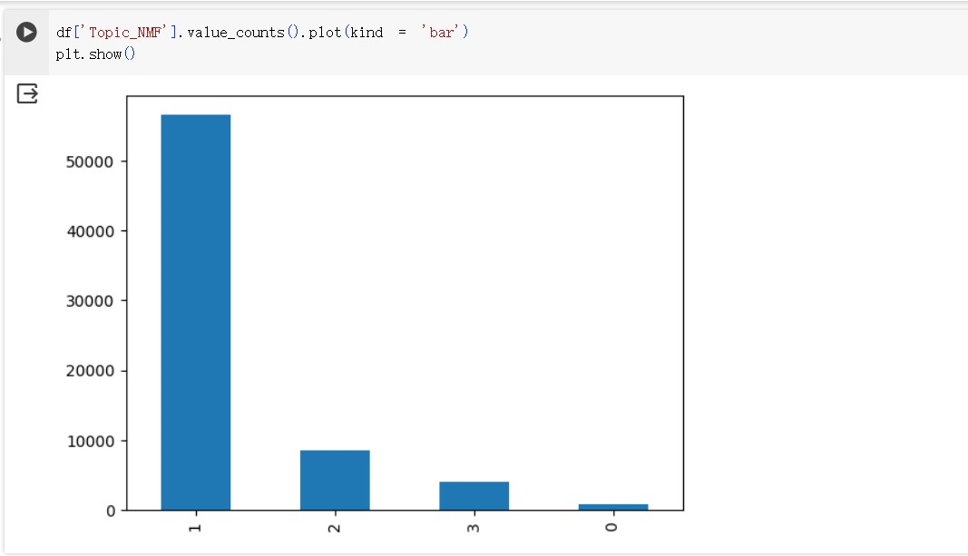
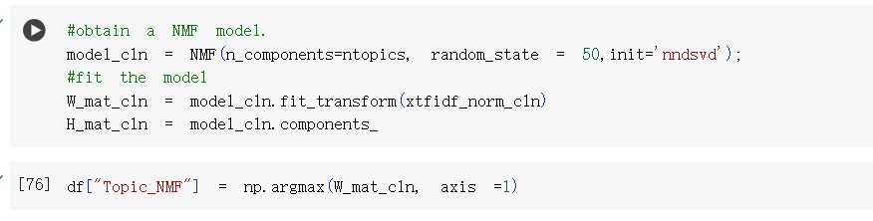
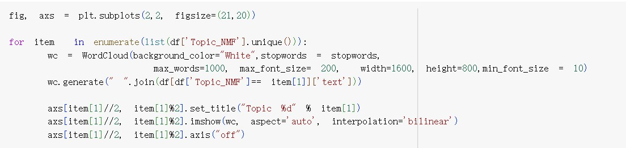
Topic Modeling: NMF

Slide 17
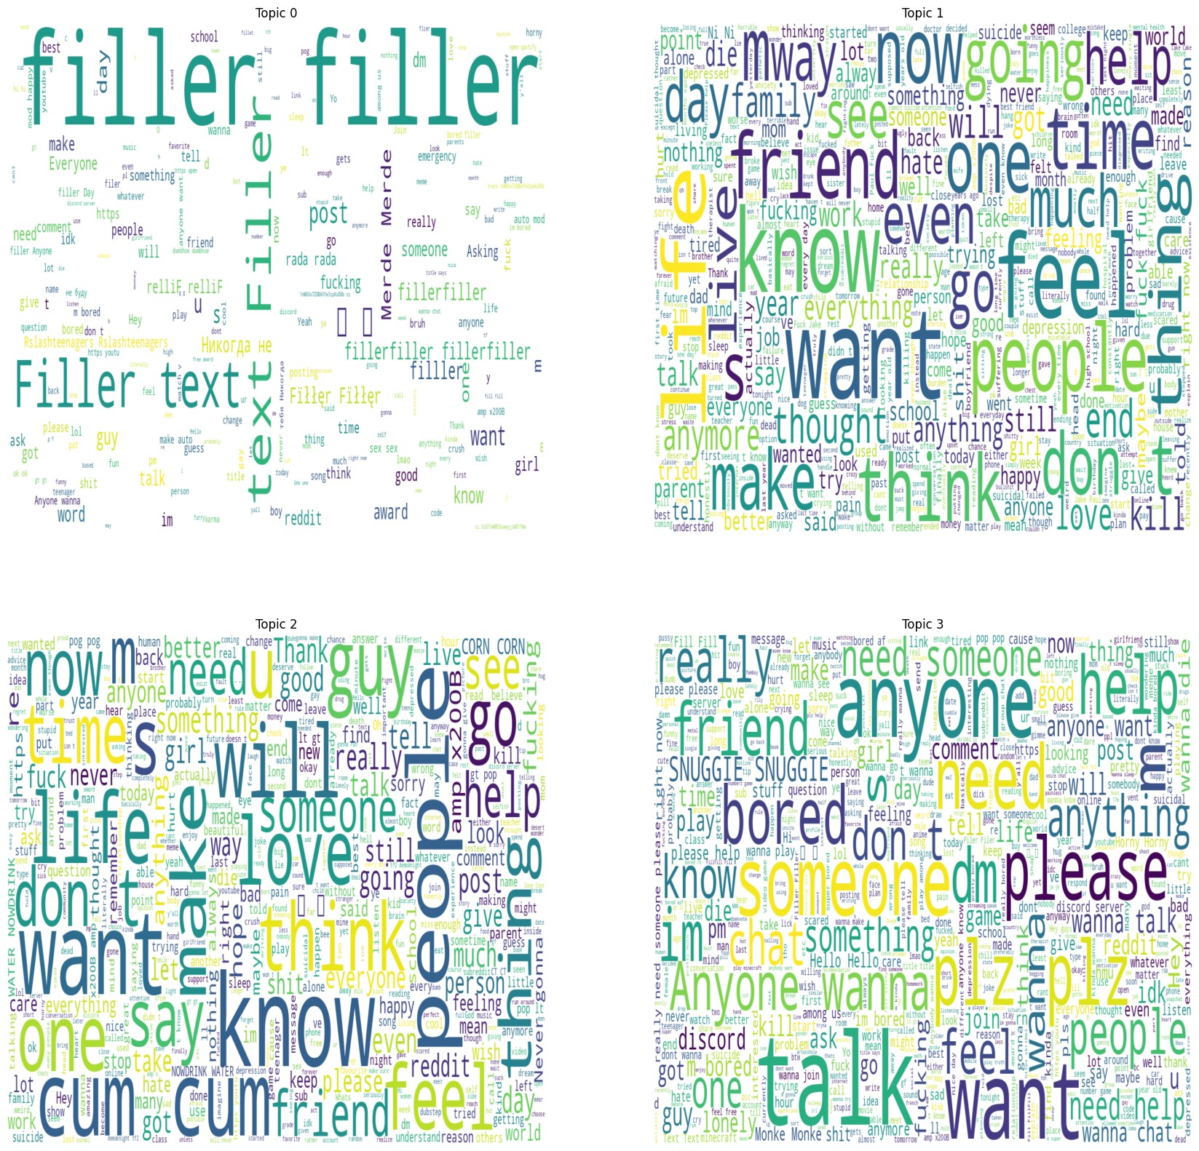

Slide 18
Thanks for Listening!

